Slide 1
ST. LUKE SERBIAN ORTHODOX CHURCH
ANNUAL MEETING
December 4th, 2022
Fr. Vasilije Vranic

Slide 2
METRICS
Baptisms – 20 (+7)
Marriages – 0 (-1)
Conversions – 2 (+2)
Deaths – 4 (0)

Slide 3
LITURGICAL LIFE
Divine Liturgies (5 December 2021 – 4 December 2022) – 142
Vespers
Royal Hours
Personal services: Baptisms, Weddings, Memorial services, Personal prayers and blessings, etc.

Slide 4
CHURCH EVENTS
Since last Annual Assembly we had 51 notable events in parish (majority recorded on Flickr Photo page of our Church)

Slide 5
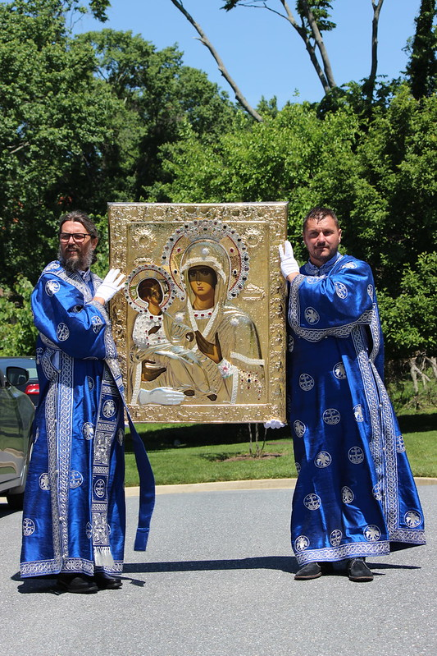
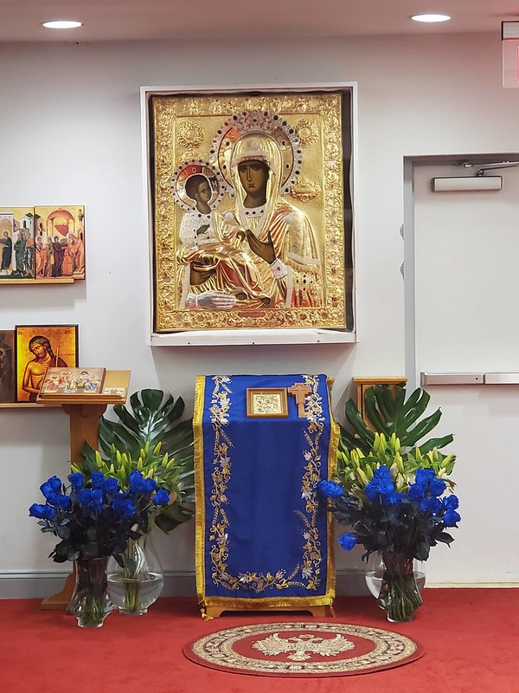
CHURCH BEAUTIFICATION PROJECT
Arrival of Icon of the Mother of God “Trojeručica“
Icon was funded EXCLUSIVELY by free will donations
THANK YOU to our group of Pilgrims who travelled to Greece to escort the Icon

Slide 6
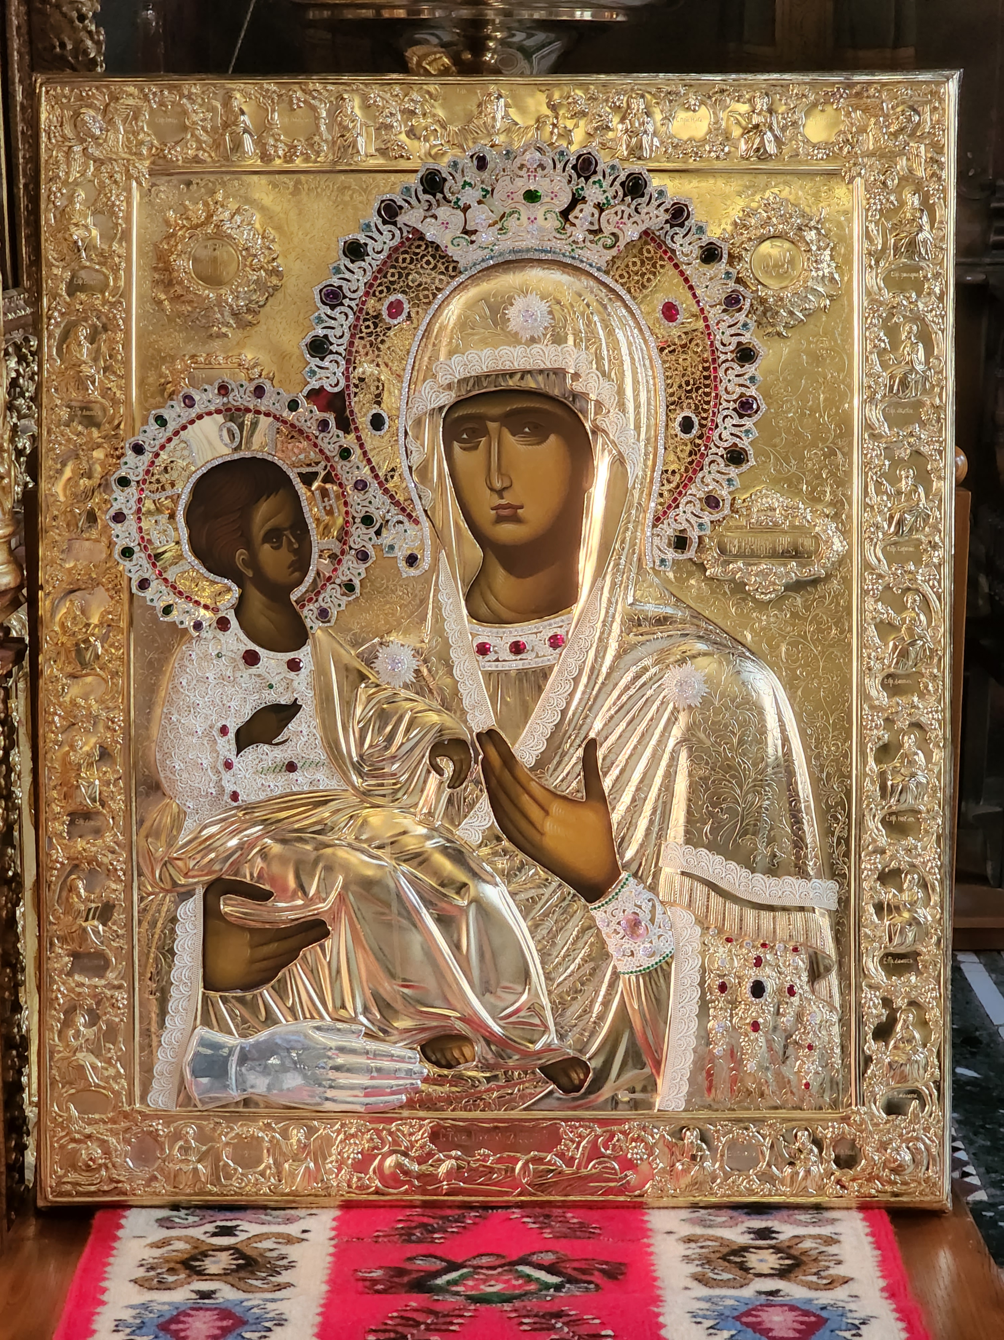
CHURCH BEAUTIFICATION PROJECT
SPECIAL THANK YOU to Dr. Donald Fish and Dr. Draginja Fish for generously donating precious stone for “Trojeručica“

Slide 7
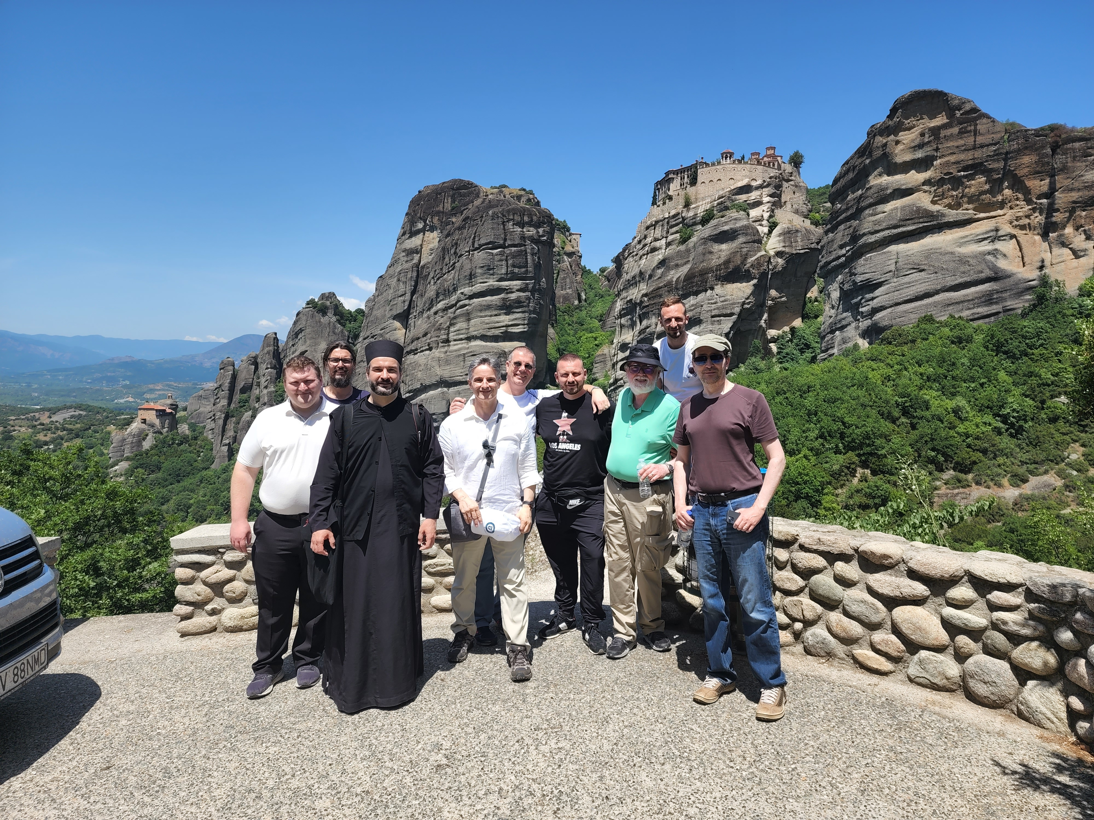
CHURCH BEAUTIFICATION PROJECT
THANK YOU to our group of Pilgrims who travelled to Greece to escort the Icon

Slide 8
CHURCH BEAUTIFICATION PROJECT UPDATE
ICONOSTASIS, ICONS, THRONE FOR THE ICON OF THE MOTHER OF GOD, BISHOP’S THRONE, AND ALTAR TABLE
COMPLETION DATE – DECEMBER 10
SHIPPING – MILSPED TRANSPORTATION COMPANY
THANK YOU TO MAYA MANDIC (ATLANTA) WHO IS COORDINATING THE TRANSPORTATION

Slide 9
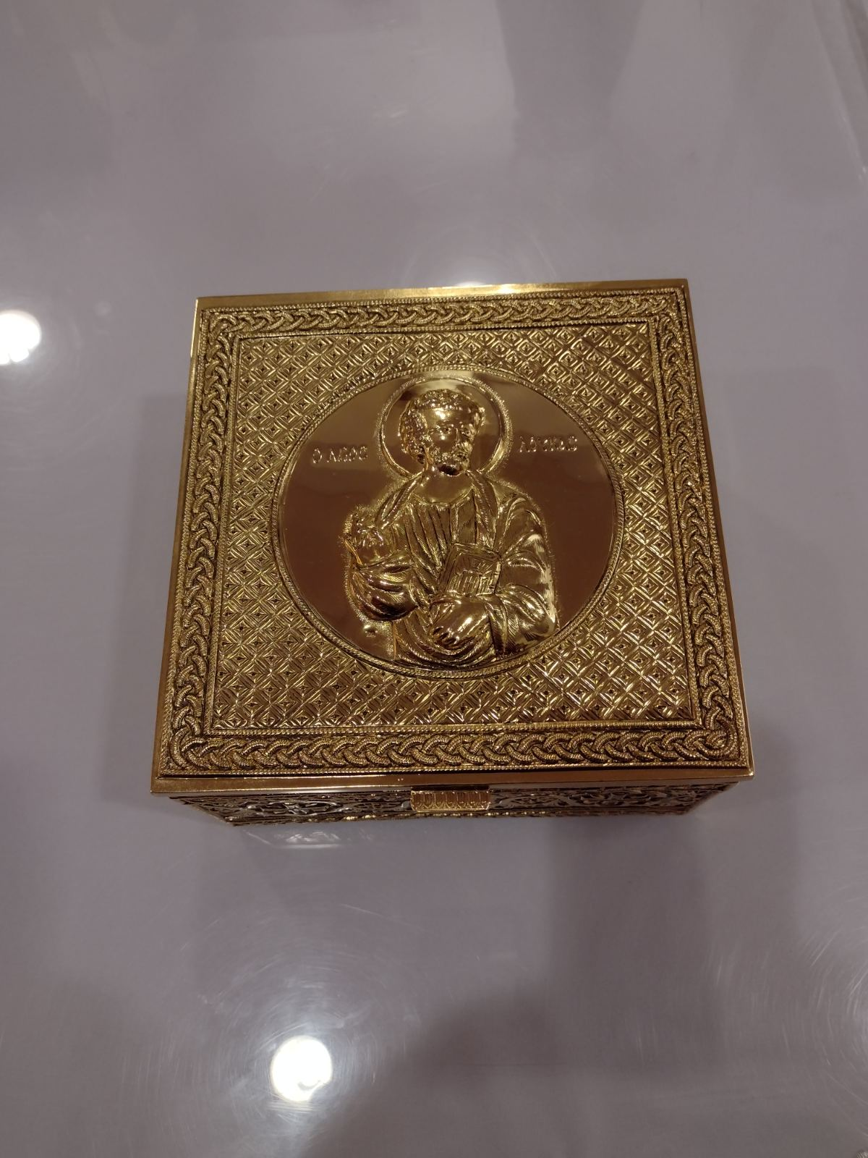
NEW RELIQUARY FOR THE RELIC OF HOLY APOSTLE AND EVANGELIST LUKE

Slide 10
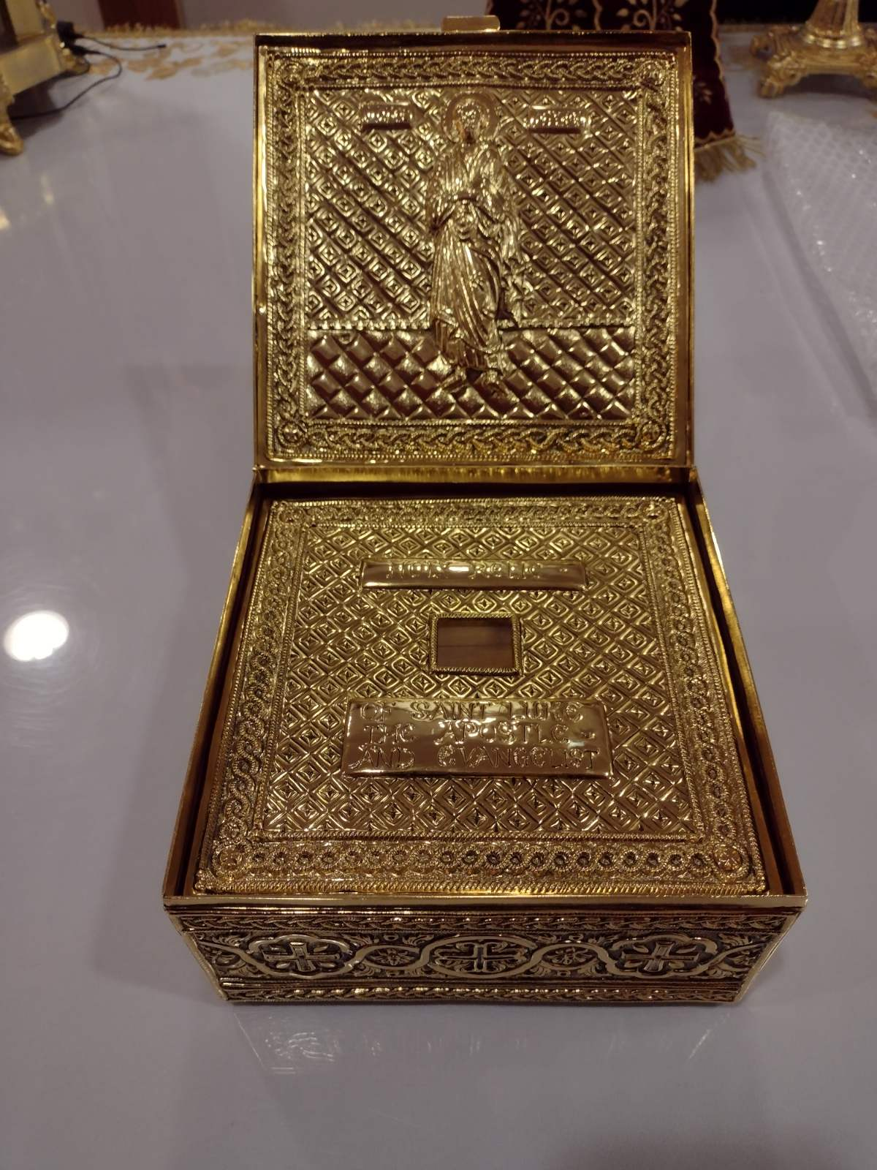

Slide 11
NEW RELIQUARIES
1. ST. THECLA (not pictured)
2. ST. GEORGE, ST. DEMETRIUS, ST. THEODORE TIRON

Slide 12
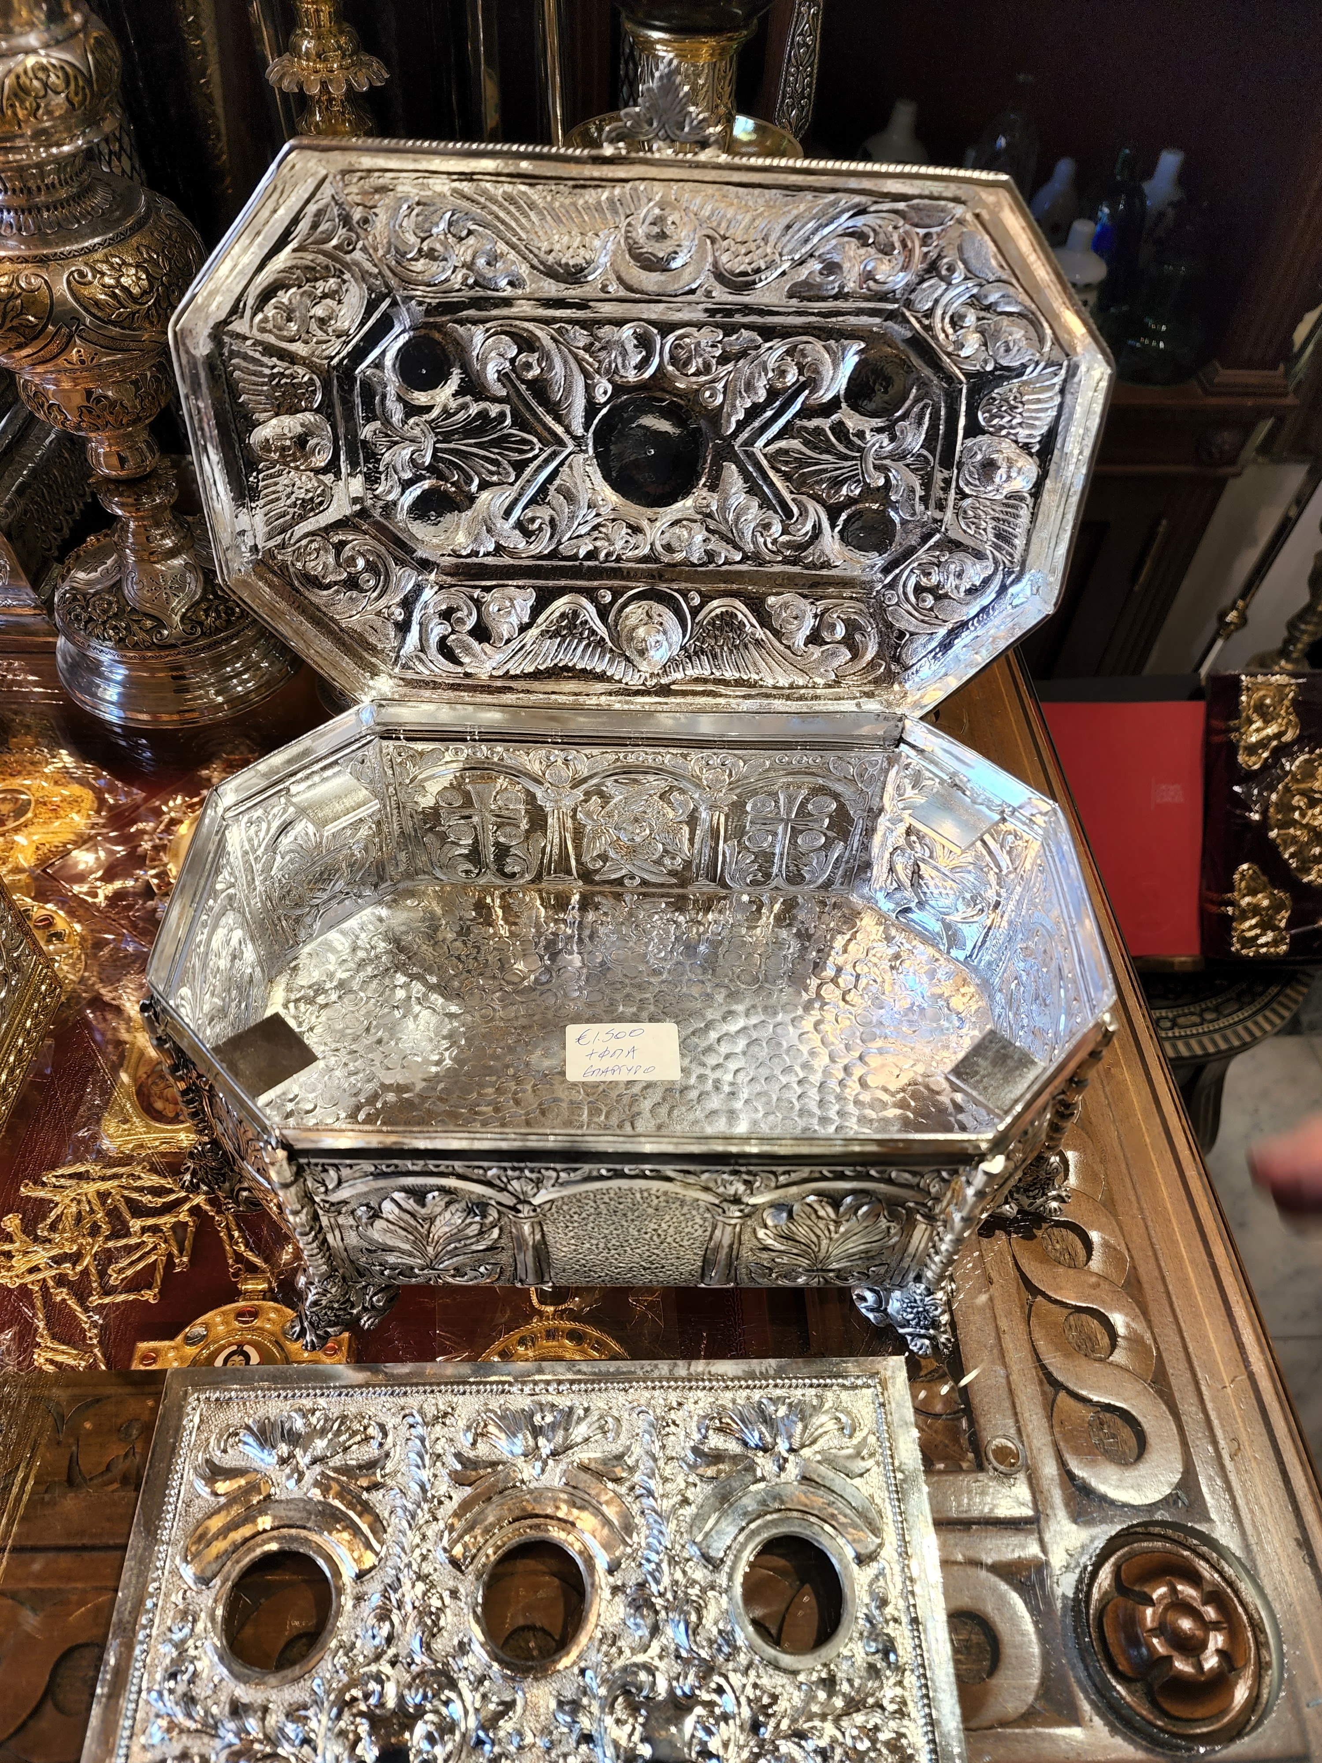
NEW RELIQUARIES
ST. GEORGE, ST. DEMETRIUS, ST. THEODORE TIRON

Slide 13
COMMUNICATION
Website: www.serbianchurch.org
Email distribution list via Mailchimp
Facebook page
Photographs from parish events stored on Flickr
Twitter
Instagram

Slide 14
THANK YOU TO PARISH MINISTRIES
CIRCLE OF SERBIAN SISTERS
CHOIR: SSS “LIRA”
SUNDAY SCHOOL/RELIGIOUS EDUCATION
SERBIAN SCHOOL “NIKOLA TESLA”
FOLKLORE GROUP “PRELO”
BOOKSTORE
CANDLE SHOP
SOCIAL EVENTS - D.C. ZURKA
SUNDAY FELLOWSHIP LUNCHEONS ?
NEW WORKSHOP – MAKING OF “BROJANICE” (PRAYER ROPES)

Slide 15
THANK YOU TO ALL OF YOU!
DEDICATION:
Tireless Help and Assistance
Generous Donations
Church Services & Candle Shop – Subdeacon Dejan Bujak
Choir
Kitchen
Festival – Mark Rasevic, Maja Lojanica, Ana Lojanica
Zurka – Snezana Nena Djokic

Slide 16
THANK YOU TO ALL OF YOU!
God bless you all for your many acts of kindness and generosity!

